Slide 1
Research discussion
Neural network background and our potential ideas

Slide 2
Governing a large country
is like cooking a small dish
治大国若烹小鲜
ancient Chinese philosopher, Lao-tzu, said

Slide 3
Contents
General Cooking
Material : Word embedding
Methods: Neural network
Quantum-style Cooking

Slide 4
Background of Neural IR
Trends of DL for IR
Word embedding
Neural network
DL for IR/NLP

Slide 5




Deep Learning Application
Computer vision
Natural Language processing [including IR]
Speech
Robots

Slide 6
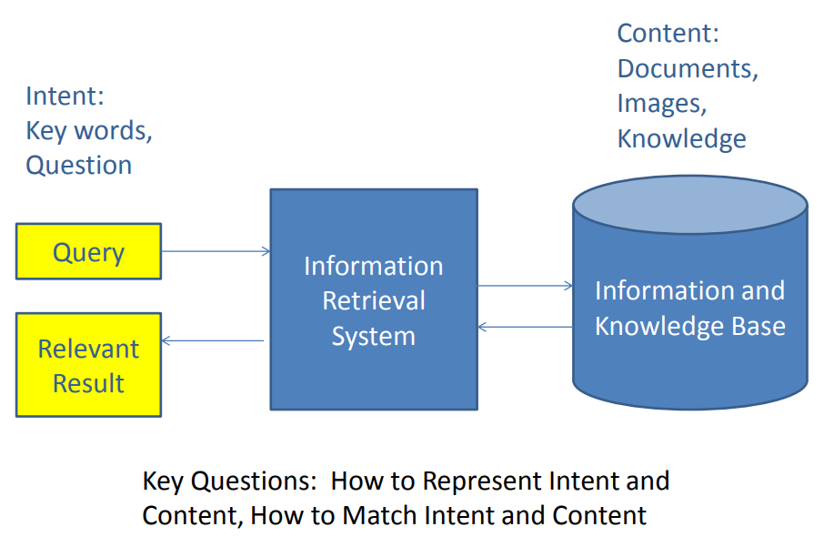
IR background

Slide 7
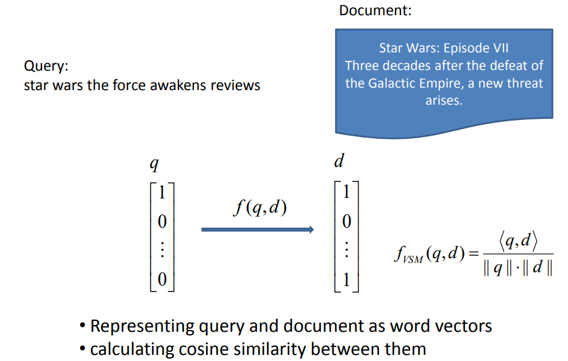
Traditional IR – Tfidf example

Slide 8
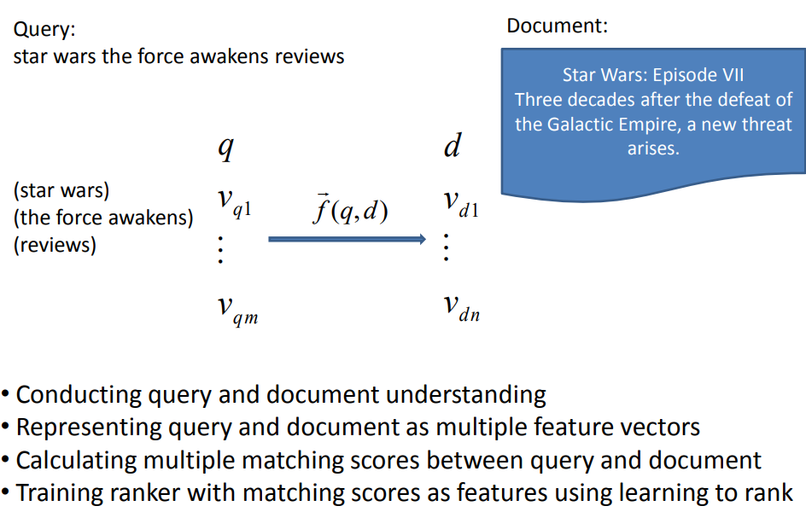
Modern IR – Learn to Rank

Slide 9
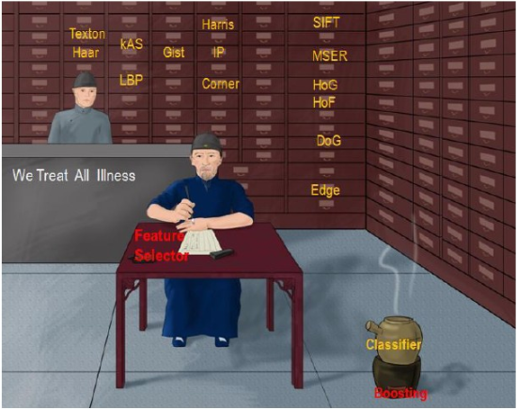
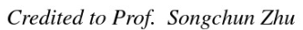
Features + Ranking
Features：
Language model
BM25
Title/Snippet/Document
Pagerank
Ranking:
Point-wise
Pair-wise
List-wise

Slide 10
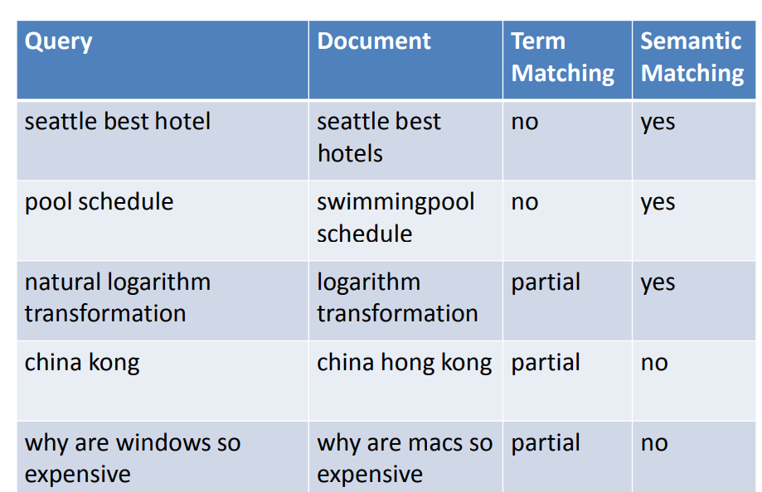
Example of Mismatch
Hang li, http://www.hangli-hl.com/uploads/3/4/4/6/34465961/tsinghua_opportunities_and_challenges_in_deep_learning_for_information_retrieval.pdf

Slide 11
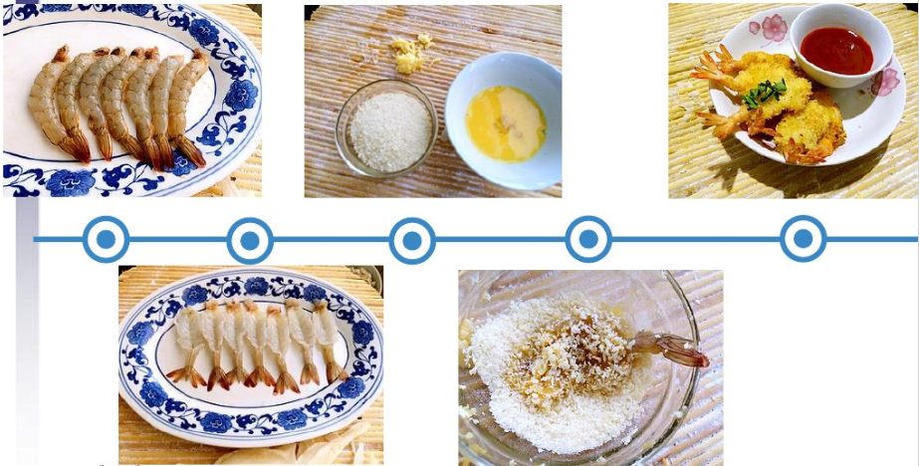
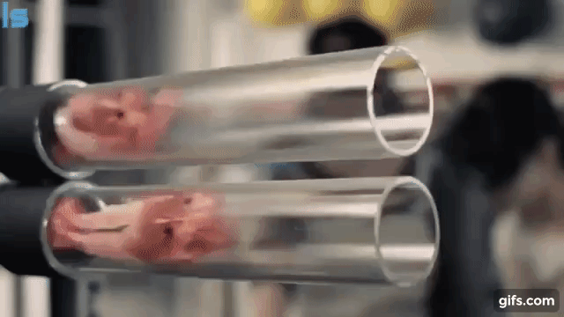
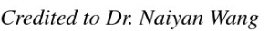
End-to-end
https://www.youtube.com/watch?v=TYpBJ71VW9g
The inputting features are also learnable/trainable

Slide 12
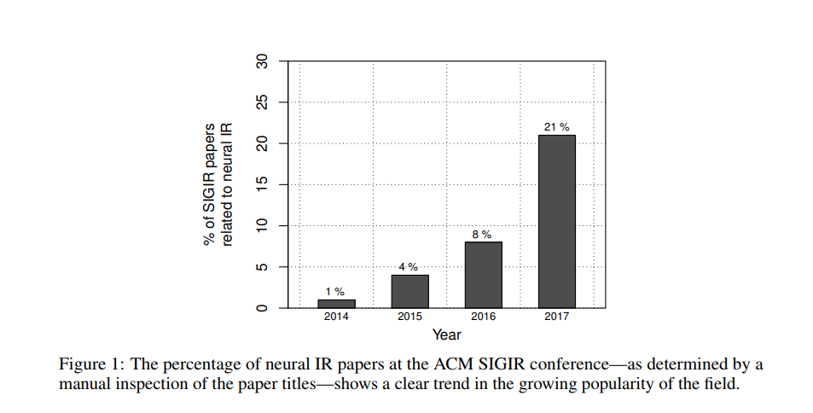
Trends for Neural IR
Mitra B, Craswell N. Neural Models for Information Retrieval[J]. arXiv preprint arXiv:1705.01509, 2017.

Slide 13
Background of Neural IR
Trends of DL for IR
Word embedding
Neural network
DL for IR/NLP

Slide 14
Localist representation
Size color … unknown
[.3, .7, .2, .1, .5]
[.5, .3, .2, .1, .0]
[.2, .0, .31, .03, .01]
[.1, .1, .5, .5, 0.2]
BMW [1, 0, 0, 0, 0]
Audi [0, 0, 0, 1, 0]
Benz [0, 0, 1, 0, 0]
Polo [0, 0, 0, 1, 0]
http://www.cs.toronto.edu/~bonner/courses/2014s/csc321/lectures/lec5.pdf

Slide 15
Distributed representation
Size color … unknown
[.3, .7, .2, .1, .5]
[.5, .3, .2, .1, .0]
[.2, .0, .31, .03, .01]
[.1, .1, .5, .5, 0.2]
BMW [1, 0, 0, 0, 0]
Audi [0, 0, 0, 1, 0]
Benz [0, 0, 1, 0, 0]
Polo [0, 0, 0, 1, 0]

Slide 16
Embedding
Distributional hypothesis
linguistic items with similar distributions have similar meanings
imaginary
Complex
Real
Life is complex. It has both real and imaginary parts
https://en.wikipedia.org/wiki/Distributional_semantics

Slide 17
How to get Distributed representation
Matrix Factorization
Word-word Matrix
Document-word Matrix
PLSA
LDA
Sample-based Prediction
NNLM
C & W
Word2vec
Glove is a combination between these two schools of approaches
Levy, Omer, and Yoav Goldberg. "Neural word embedding as implicit matrix factorization." Advances in neural information processing systems. 2014.

Slide 18
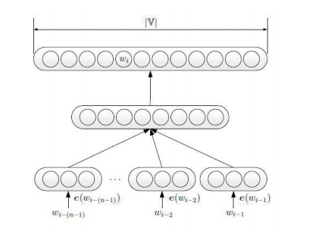
NNLM to Word2vec
Negative sampling
Hierarchical softmax
Concat -> mean
Bengio Y, Ducharme R, Vincent P, et al. A neural probabilistic language model[J]. Journal of machine learning research, 2003, 3(Feb): 1137-1155.
Mikolov T, Chen K, Corrado G, et al. Efficient estimation of word representations in vector space[J]. arXiv preprint arXiv:1301.3781, 2013.

Slide 19
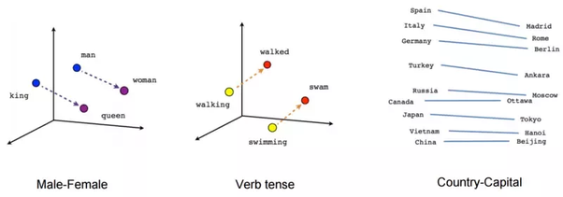
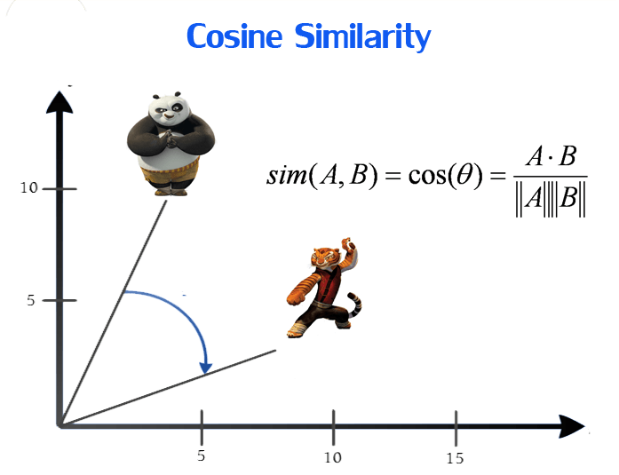
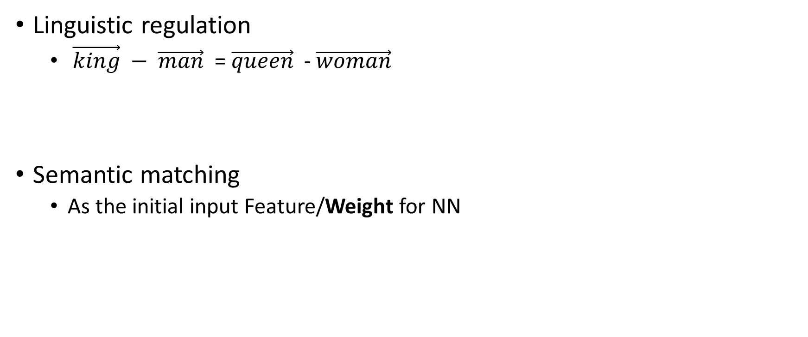
Advantage of word embedding
Linguistic regulation
$\vec{king} − \vec{man}$ = $\vec{queen}$ - $\vec{woman}$
Semantic matching
As the initial input Feature/Weight for NN

Slide 20
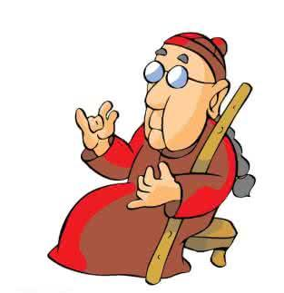
Only Word Embedding ?
Which is the most similar word of “Italy” ?
Maybe “Germany” or “Pasta” ?
You cannot guarantee that each similar word pair could help your matching ?
Nie Jianyun said in SIGIR 2016 Chinese-Author Workshop, Tsinghua University, Beijing

Slide 21
Background of Neural IR
Trends of DL for IR
Word embedding
Neural network
DL for IR/NLP

Slide 22
Neural Network
MLP
CNN
Shift/Space invariant
Recurrent NN - [LSTM/GUR]
Time-sensitive
Recursive NN
Structure-sensitive
Special Case
Seq2seq
GAN
Reinforced Learning

Slide 23
MLP

Slide 24

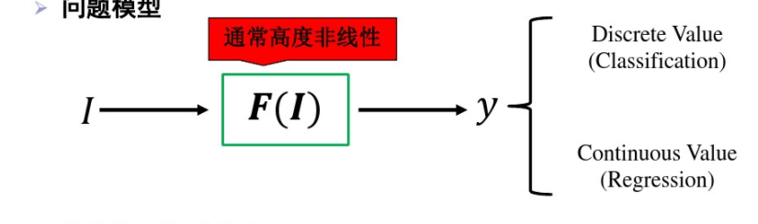
UAT in MLP
Multi-layer Non-linear Mapping - > Universal Approximation Theorem

Slide 25
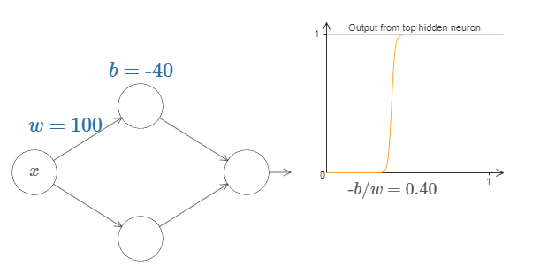
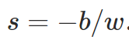
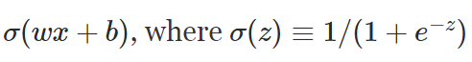

A sample of $θ$(wx+b)
http://neuralnetworksanddeeplearning.com/chap4.html

Slide 26
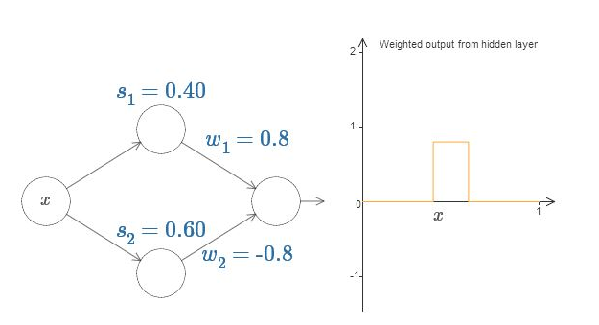
An another sample

Slide 27
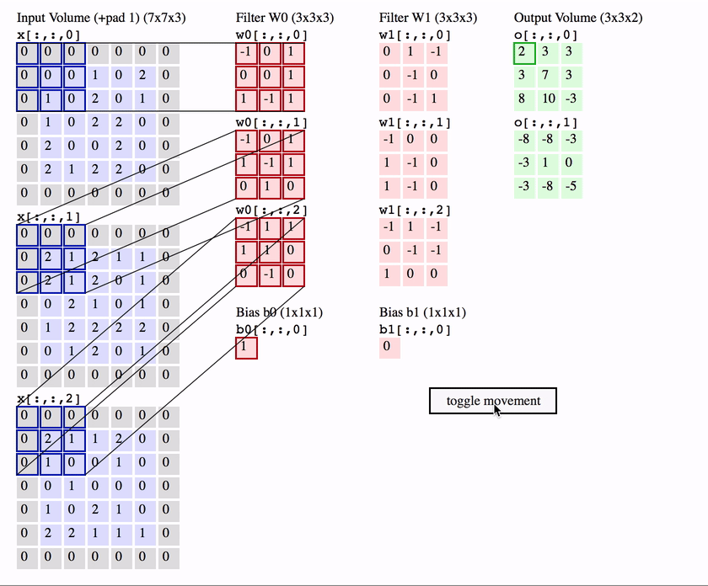
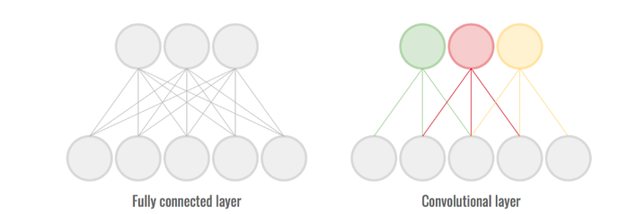
From MLP to CNN
Local connection
Shared weight
Pooling strategy

Slide 28
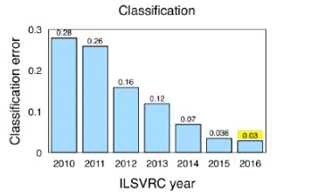
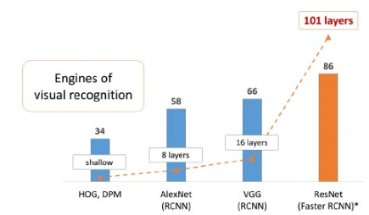
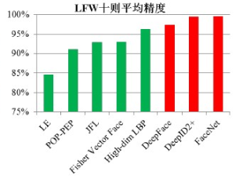
Deep NN in CV
Top 5 error in ImageNet classification
10-fold mean precision Face recognition LFW dataset
MAP in Pascal VOC visual recognition
Deep NN

Slide 29
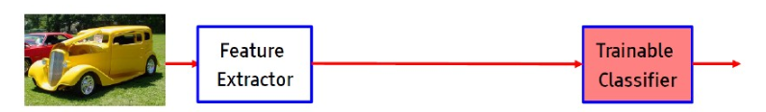
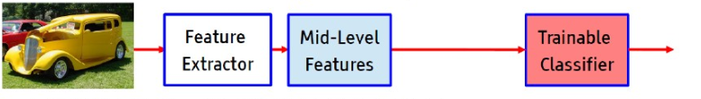
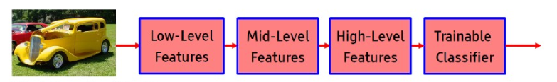
End-2-end in CV
Tradition CV
Modern CV： Unsupervised mid-representation
DNN CV ： end-2-end

Slide 30
CNN
Basic CNN
Kalchbrenner N, Grefenstette E, Blunsom P. A convolutional neural network for modelling sentences[J]. arXiv preprint arXiv:1404.2188, 2014
Kim CNN
VDCNN

Slide 31
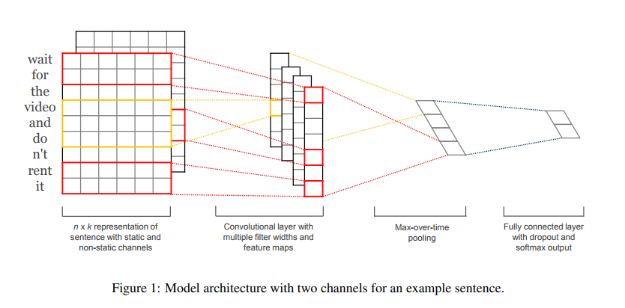
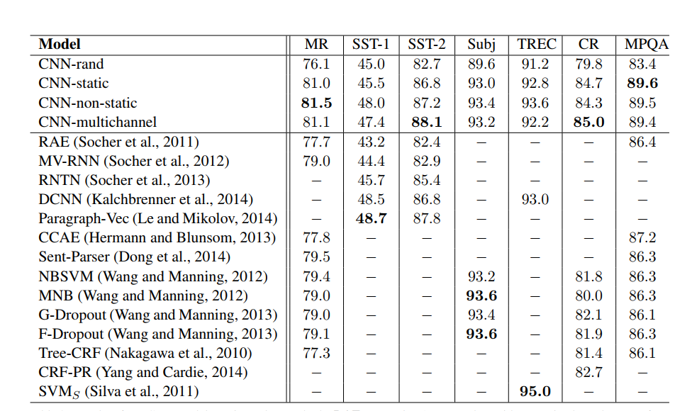
CNN [kim EMNLP 2014]

Slide 32
Go deeper or not?
DEEP
Slower
Overfitting
More Parameters, more data need to feed
Hard for convergence
Highway network
Residual Block
Inception
Shallow: one-layer
Fast
Less data, es. Fastext.

Slide 33
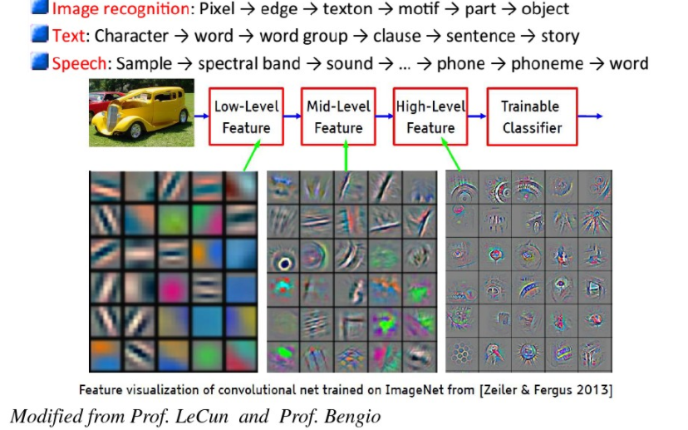
Go deeper or not?

Slide 34
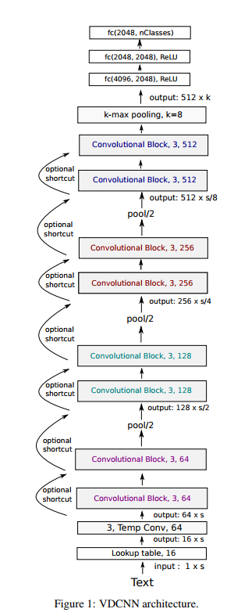
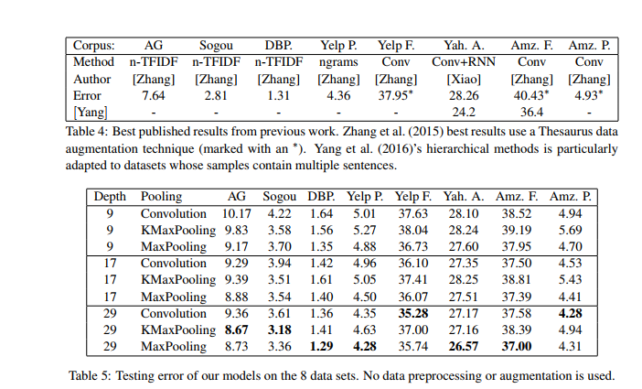
Very Large CNN [Conneau EACL ]

Slide 35
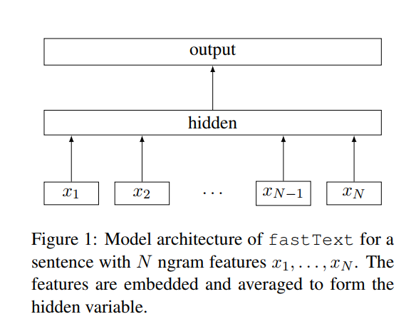
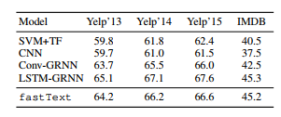
FASTEX [EACL 2017]

Slide 36


RNN

Slide 37
RNN

Slide 38

Forget gate

Slide 39

Input gate
replace tanh with softsign (not softmax) activation for prevent overfitting
https://zhuanlan.zhihu.com/p/21952042

Slide 40

Forgotten + input

Slide 41

Output Gate

Slide 42
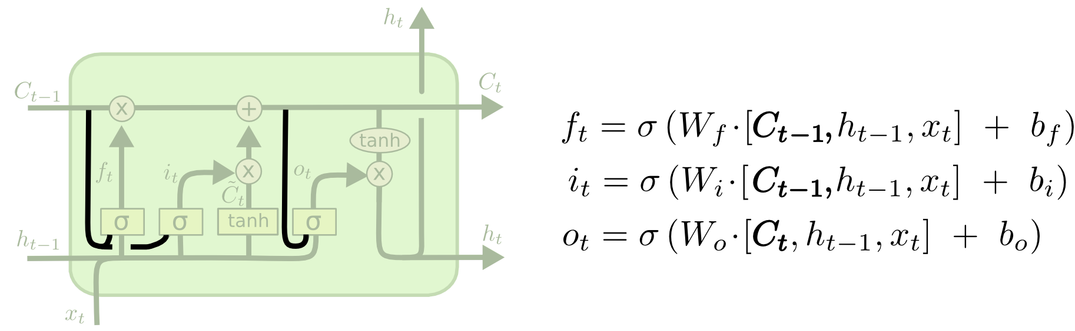
LSTM Variants: Peephole connections

Slide 43
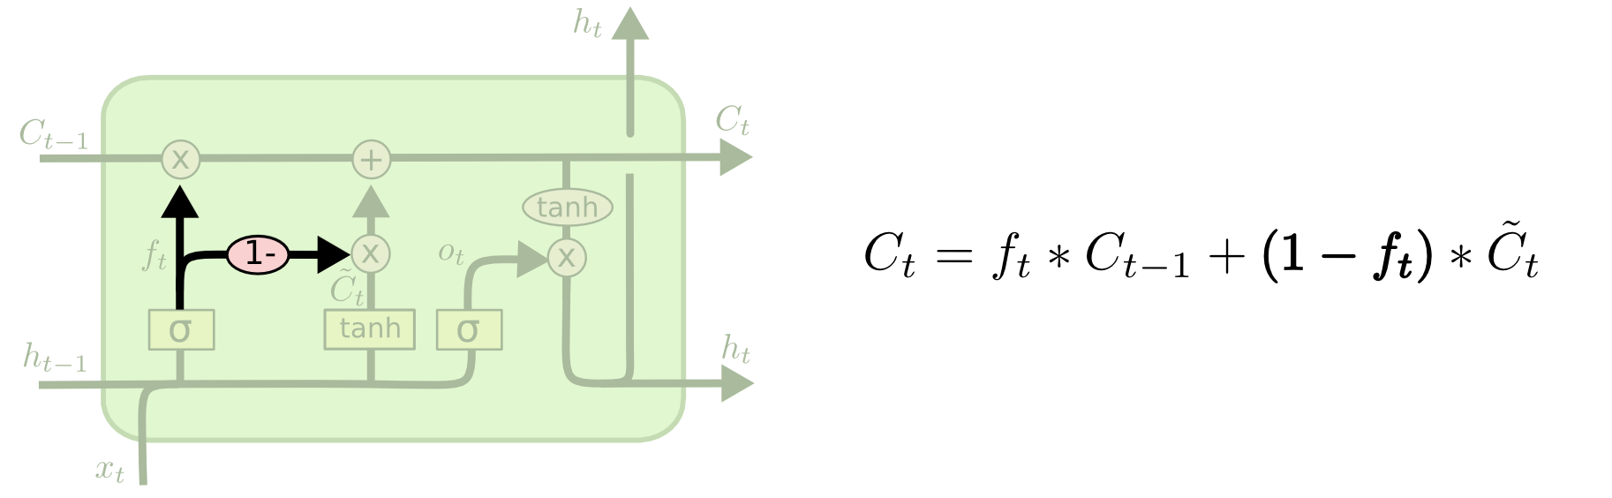
LSTM Variants: coupled forget and input gates

Slide 44

LSTM Variants: GRU
Hidden = Cell
Forget gate + input gate =1

Slide 45
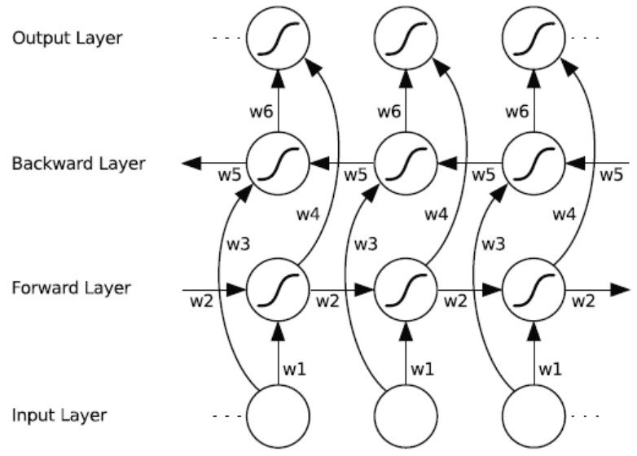
BiLSTM

Slide 46
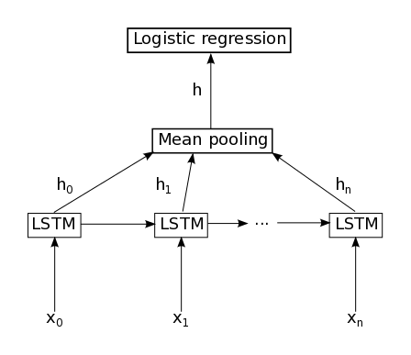
Last or Mean?

Slide 47
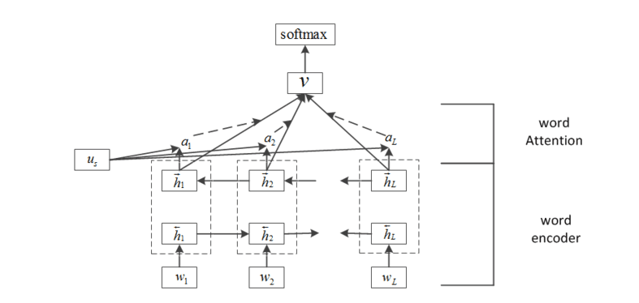
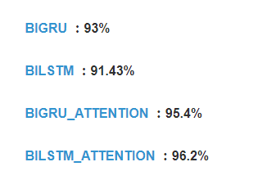
RNN/LSTM with Attention
https://www.jianshu.com/p/4fbc4939509f

Slide 48
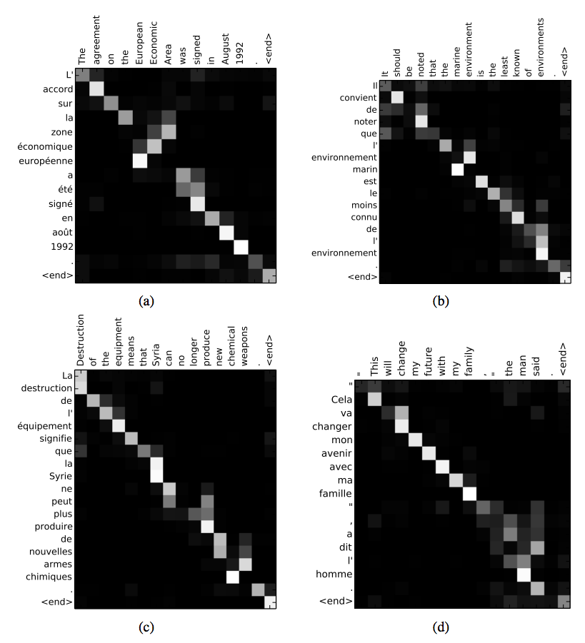
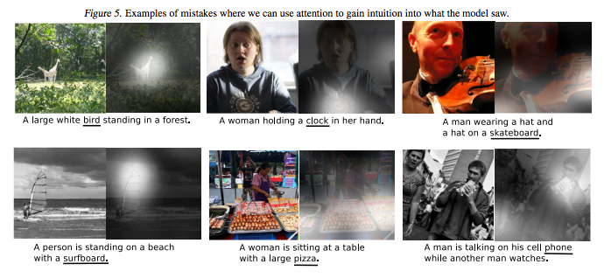
Visualization of Attention in RNN/LSTM
Image Caption
Machine Translation

Slide 49
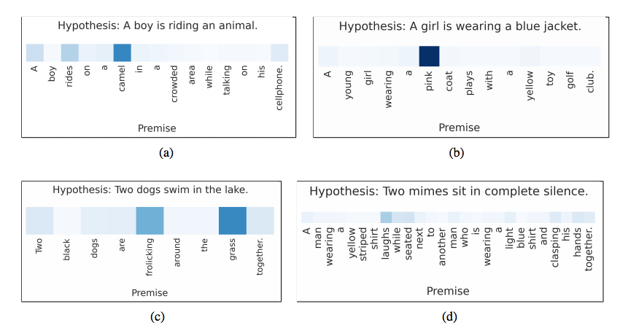
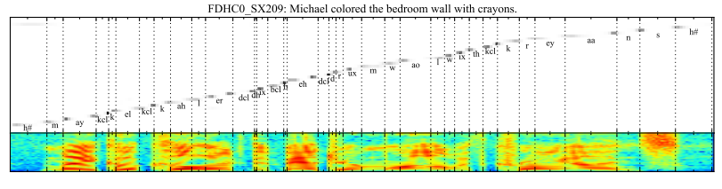
Visualization of Attention in RNN/LSTM
Sematic Entailment
Speech Recognition

Slide 50
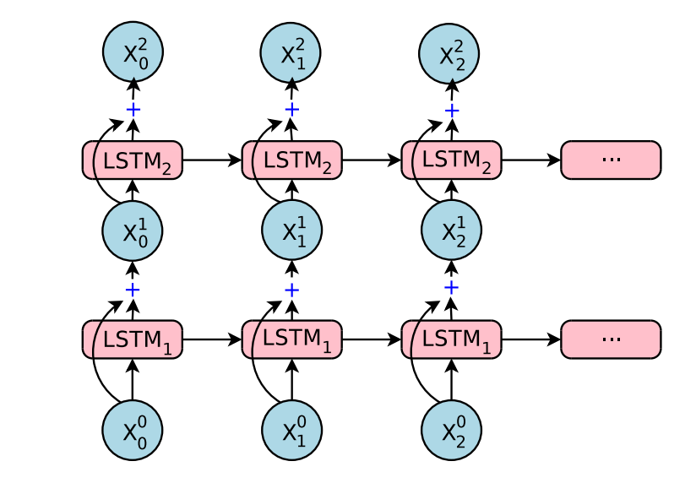
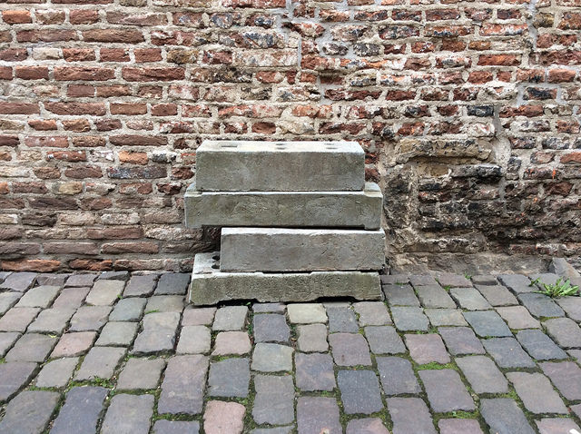
Deeper LSTM
Deep is not necessary, but more feeding data!!!

Slide 51
Background of Neural IR
Trends of DL for IR
Word embedding
Neural network
DL for IR/NLP

Slide 52
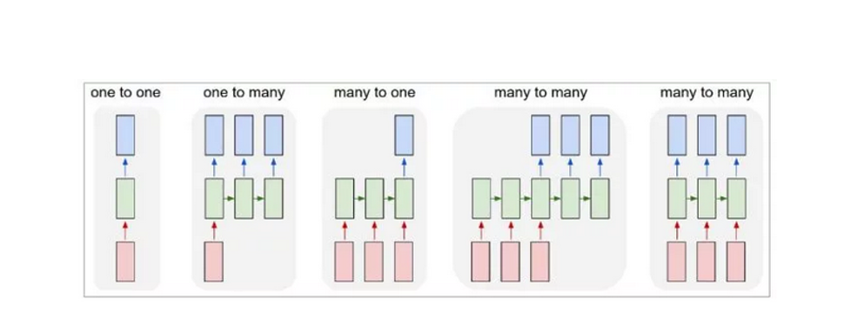

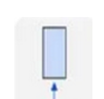
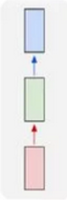


Tasks in IR/NLP
Credited by Hang li

Slide 53
Fundamental Demo In Code with PyTorch pseudo code
Model = LSTM/CNN/Capsule/…
text,lable = Dataset.nextBatch()
representation = Model(text)
Classification = FC(representation) FC : Mapping to label size
Translation = Decode(representation)
Matching = Cosine(representation1, representation2)
Sequential_labelling = FCs(representations )

Slide 54

Seq2seq

Slide 55

GAN
https://skymind.ai/wiki/generative-adversarial-network-gan

Slide 56

Reinforced learning
Compared to the supervised learning:
You can not know the current reward from the current action, namely a delayed reward,
only in the case that the game is finished.
https://www.kdnuggets.com/2018/03/5-things-reinforcement-learning.html

Slide 57
Quantum-style Cooking
Hilbert semantic space
Complex word embedding
Hilbert semantic space
Application in Text classification
Application in Question Answering
Ideas
Dynamics for thematic issues
Evolved Density matrix for language model

Slide 58

Complex word-embedding
Super-linearity superposition with phase
Li Qiuchi, Uprety Sagar, Wang Benyou , Song Dawei Quantum-inspired Complex Word Embedding, ACL 2018 3rd Workshop on Representation Learning for NLP , ACL 2018 RepL4NLP

Slide 59
Hilbert Semantic Space
Unify these four things in a complex-valued space
Sememes
Word
Phrase/Sentence/Documents
Topic as measurements

Slide 60

Definition
Sememes as basic state
Word as superstition state
Sentence as mixed system

Slide 61
Complex word embedding
Dimension: the number of
Length : weight
Amplitude part: meaning
Phase part: polarity ?
How to infer the overall polarity from the polarity of each words?
Is there any quantum phenomena here ?

Slide 62

Trainable Measurements for sentence classification

Slide 63

Framework

Slide 64

Implements

Slide 65

Physical meaning for our models

Slide 66

Experiments

Slide 67

Case study for our measurement

Slide 68

Implements for matching

Slide 69

Case study

Slide 70



Experiments

Slide 71

Weights

Slide 72

Learned measurements

Slide 73

Ablation Test

Slide 74
Potential ideas
Representation based on vector space
Deep investigation of complex vector space
Semantic Hilbert vector space for interpretable NN like Capsule
Overview of word embedding
Dynamics in vector space
Evolved density matrix for language model
Dynamic word embedding via tensor decomposition
Investigate the dynamics with time-aware multi-turn dialogue

Slide 75
Ideas
Dynamics for thematic issues
Evolved Density matrix for language model

Slide 76


Dynamics for thematic issues
Concatenate the Document-Term or Term-Term Co-occurrence as a Tensor
$[{M_{t}}_{1},{M_{t}}_{2},…,{M_{t}}_{T}]$ as $T_{t,d,w},$ 3-d Tensor, where ${M_{t}}_{1}$ is the D-W matrix.
Tensor composition/factorization machine for time-aware word embedding
Obtain the neighbor words of “nuclear” in different time stamp.

Slide 77

Linking embedding with topic/thematic issue
For a topic, it is usually considered as a distribution of words
$p^{(i)}=p(p_{w_{1}},p_{w_{1}},…p_{w_{|v|}})$
For a word embedding, its neighbor has a well-designed distance, we could also get a distribution as $p_{w_{j}}= \frac{e^{d_{ij}}}{∑e_{}^{d_{ij}}}$.
In a sense, word embedding is considered lower-level topic
Word embedding
Topic
Thematic issue

Slide 78


Evolved Density matrix for language model
$1. α={\left\langle h | e_{w_{i}}\right\rangle }^{2}$
2. $ρ^{(t)}= {Uρ}^{(t−1)}U^{∗}∗α+\left|e_{w_{i}}\right\rangle \left\langle e_{w_{i}}\right| ∗\left(1−α\right)$
3. $p_{w_{j}}=tr(ρ\left|e_{w_{j}}\right\rangle \left\langle e_{w_{j}}\right|)$

